Slide 1
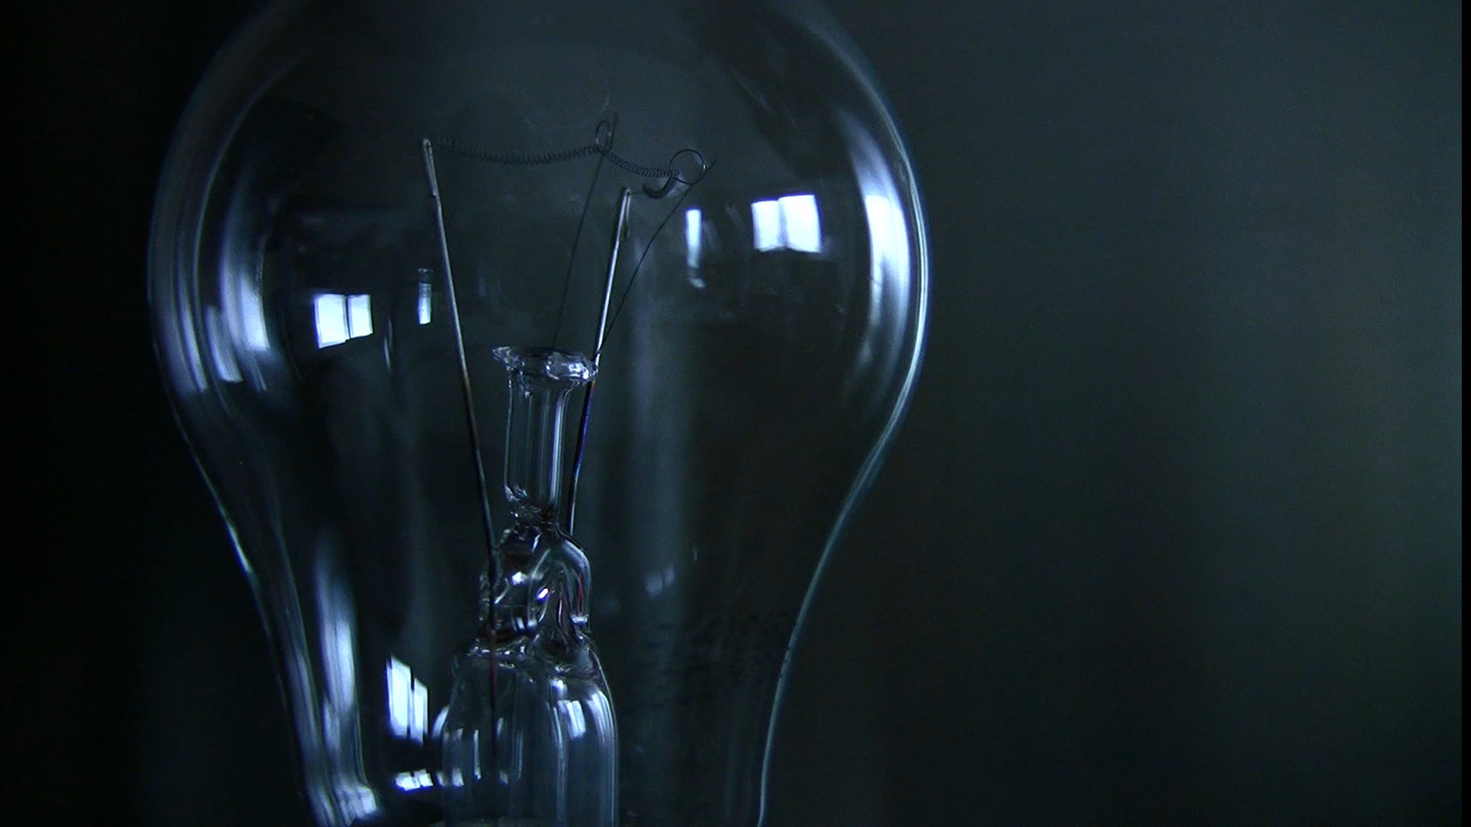
Real time electricity plan recommendation system for common house holds
Asim Javed

Slide 2

Background
Increase in Electricity demand in domestic sector, 60 % by 2030
31 % of US household fail to pay their electricity and choose to forgo vital necessities such as food and medicines
Several smart energy home solution have been proposed, require difficult transformations by the users, lack real time user interaction
Customers hate intrusion of their privacy. Not cost Effective!
User habits and patterns are the most important variable that can help reduction in energy usage
Need recommendation system that is user specific
What to do if there is no on-peek and off-peak time

Slide 3
Objectives
Create personalized suggestions that are tailored to a household’s energy consumption and usage of appliances and assist in achieving energy footprint reduction objectives by reducing excessive energy use.

Slide 4
Plan of action
Nonintrusive load monitoring: Disaggregation of power usage into individual appliances
Generate real time recommendation by mining users' frequent activity
Interaction with user using intuitive UI
Shows recommendations
asks users to turn off appliances, incase not a frequent activity
Keeps seasonality in mind
Displays weekly appliance level energy consumption

Slide 5
Available datasets
Some popular energy datasets include
UCI
REDD
PLAID
We require dataset that has
Overall power consumption
Power drawn by individual appliances
Hence, we use UK dale dataset

Slide 6
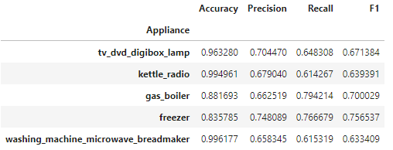
Energy disaggregation
Getting the ON OFF data
K-Means clustering(with K=2), to split each appliance’s readings into two clusters. The off label was assigned to the cluster with lower value readings, and the on label to the cluster with higher value readings. Better than just using threshold.
Preparing the dataset
For a timestamp sum all the appliances states get binary and convert it into decimal. A train test split is performed (50:50)
Prediction
Get overall consumption for all the above time stamps and predict the target using XG boost model.
Target is then decomposed into states for each appliance
Evaluation

Slide 7
Energy pattern extraction
Pattern mining method Apriori is used.
Appliance sets that are frequently used together in the same day segment are discovered by Apriori are stored in a dictionary.
The next step is to extract rules from the frequent appliance sets of each day segment and use these rules as the user’s behavior concerning the usage of appliances at the specific segment.
House has 18 appliances using a support of 0.02 generates frequent itemsets and includes 17/18 appliances if support is reduced to 0.01 the 18th device playstation is also visible whereas increasing the support to 0.03 reduces appliances from the frequent itemset. Thus, a support of 0.02 is chosen
Using this subset of generated sequences, we can generate a map of appliance names and their active time slots. From this data, we get the knowledge about when a user uses a particular appliance in the whole day. This can be directly related to the user habits as we can successfully make the connection between the appliance state and the user activity

Slide 8
Appliance usage recommendation
Recommendations are sorted by their confidence scores; top recommendation is shown on the user interface.
If the user switches on something that is different from his routine an alert is generated to turn of that device.
Our recommendation shows to turn on dishwasher form 6 to 10pm which is when user normally turns the dishwasher on, other appliances show a similar trend

Slide 9
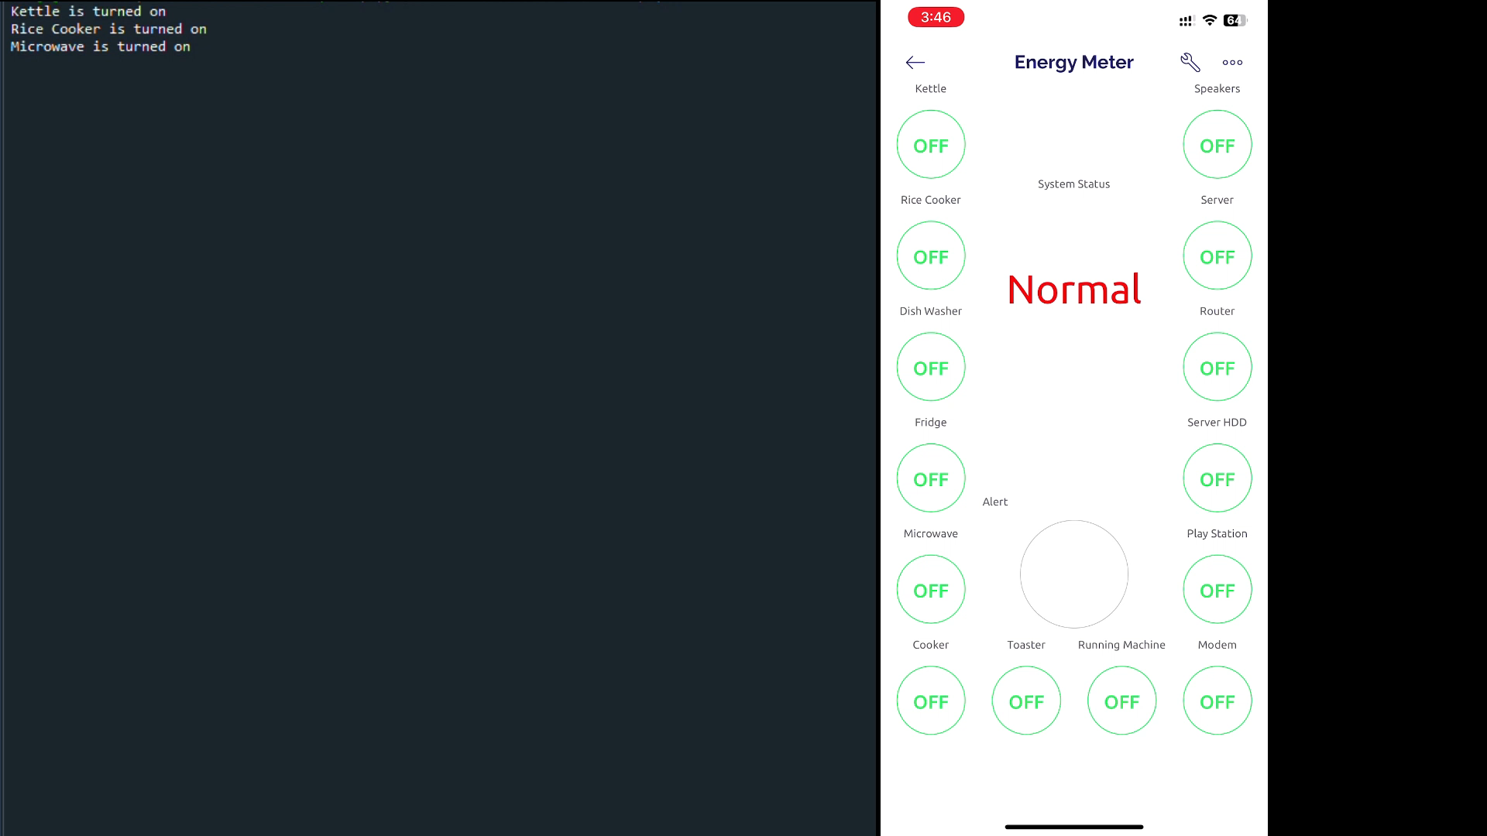
User Interface

Slide 10
Evaluation
We use evaluation procedure proposed by Eirinaki Magdalini [1]
We generate recommendations and observe that overall, the algorithm accurately predicts appliance usage achieving high recall (i.e., the system correctly predicts appliances that were on). In addition, and most importantly, we estimate how much energy could be saved if the users followed the recommendations and turned appliances off as prompted.
For each time period, we estimated the energy used by all the appliances that were on in the test set but were advised to be off by the system. This is energy that can be saved if recommendation are followed
We show that these savings range from 3 to 15%.

Slide 11
References
https://www.frontiersin.org/articles/10.3389/fdata.2022.972206

Slide 12

Questions?

